Slide 1


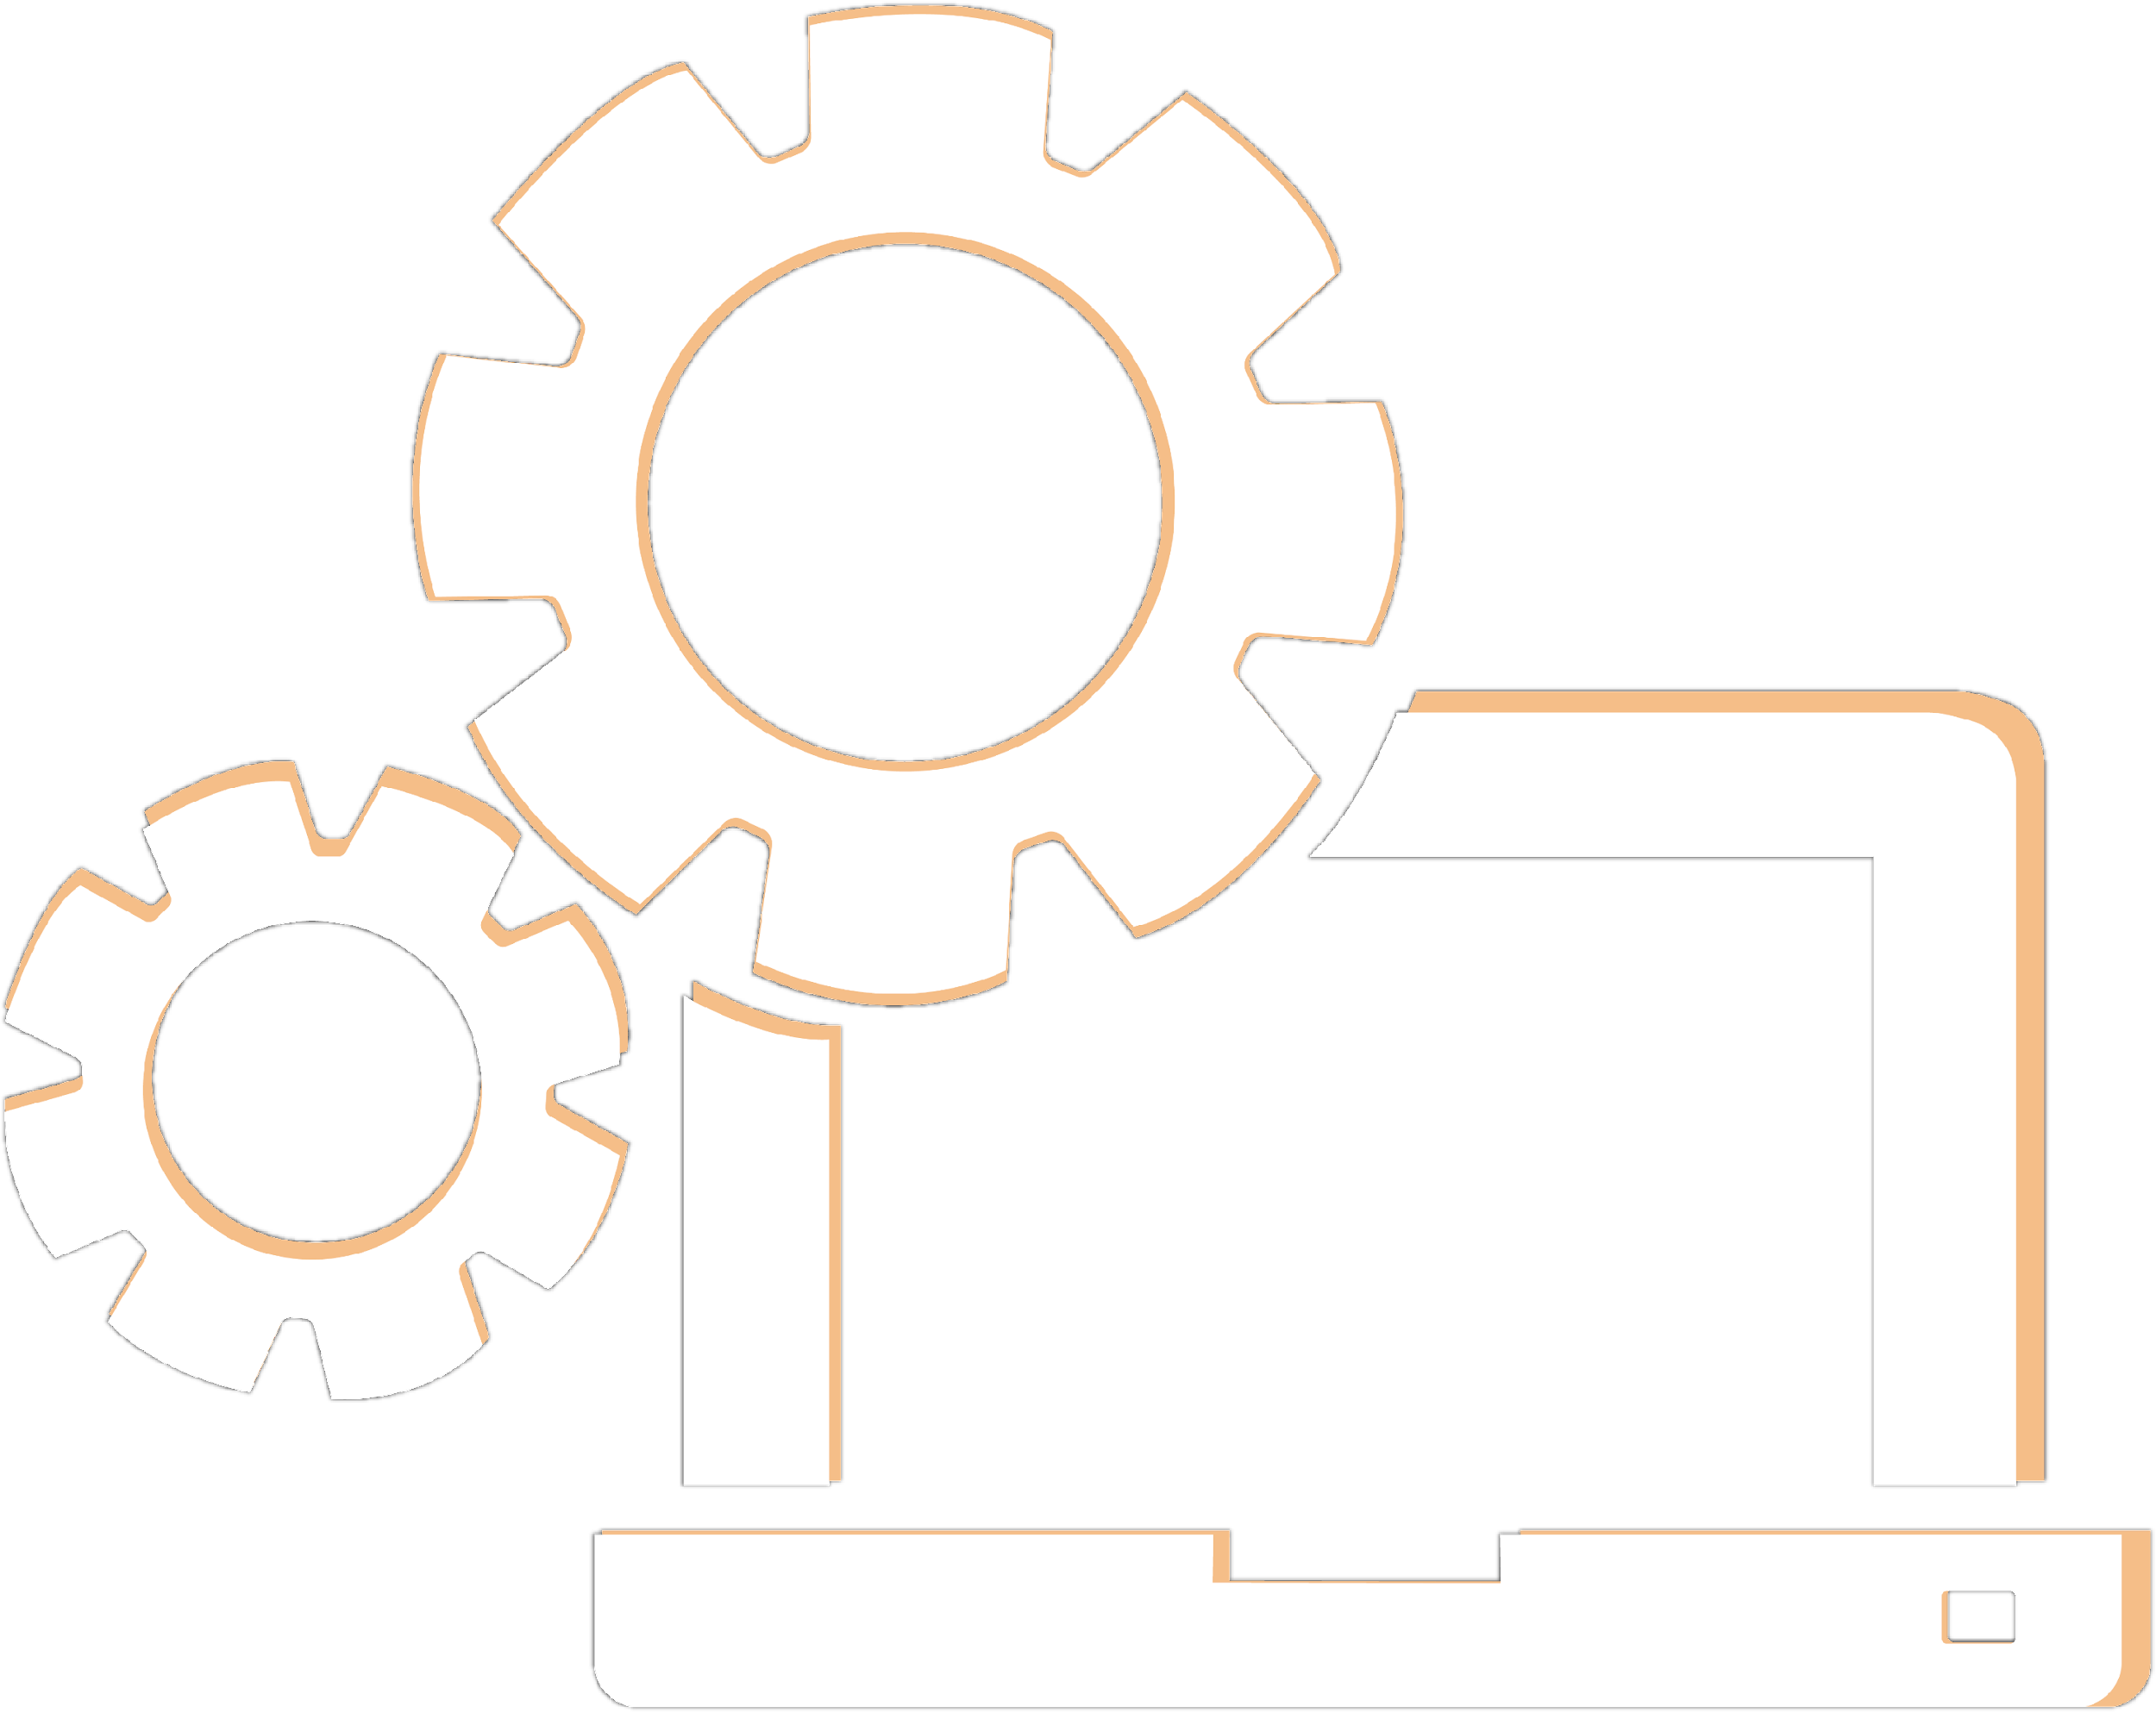
NIC-PARAM
Network
Lecture No. 02
By- MD IMRAN A

Slide 3
01 Technologies in Cloud Computing
02 Cloud Service Model
TOPICS TO BE COVERED
03 Overview Computer Networks
04 Basic Principles of Computer
Network
05 Development of Computer
Network

Slide 5
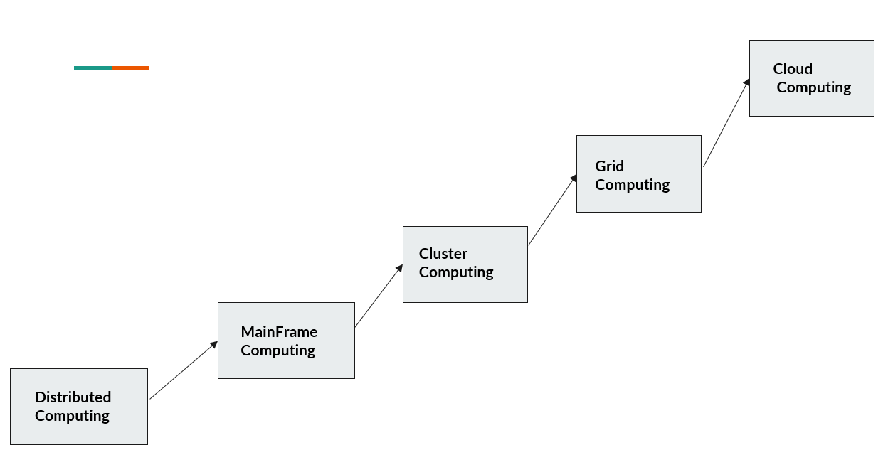
Evolution of Cloud Computing

Slide 6
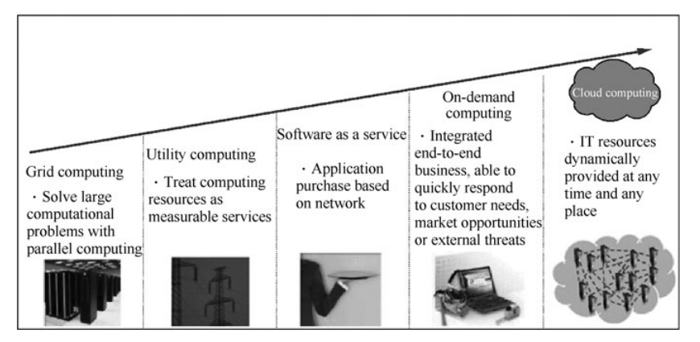

Slide 7
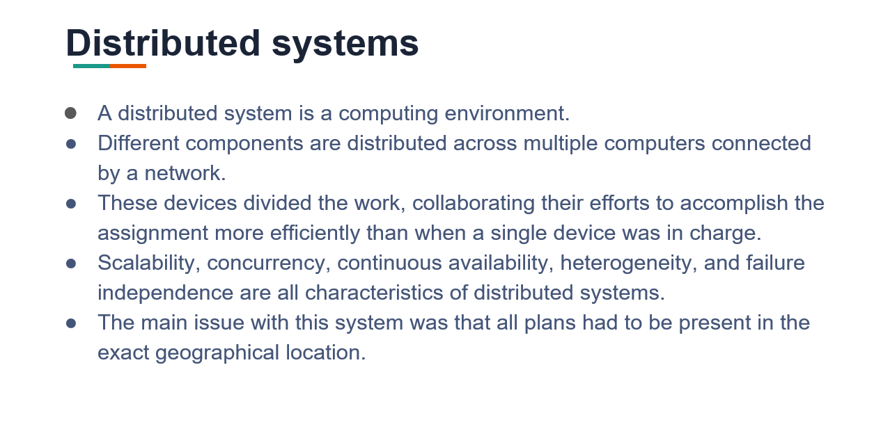

Slide 8
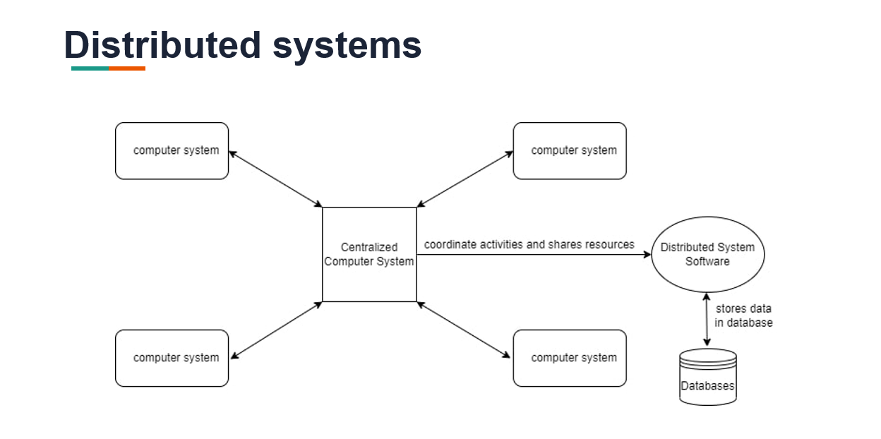

Slide 9
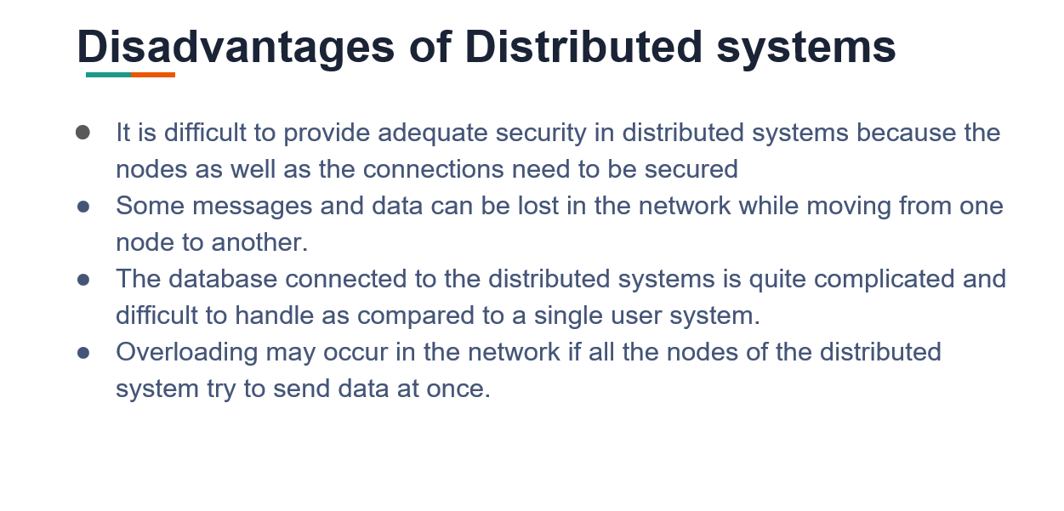

Slide 10
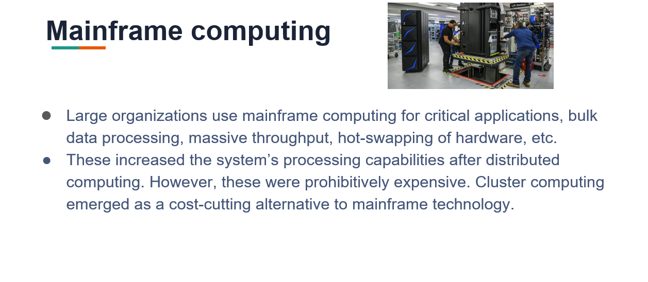

Slide 11
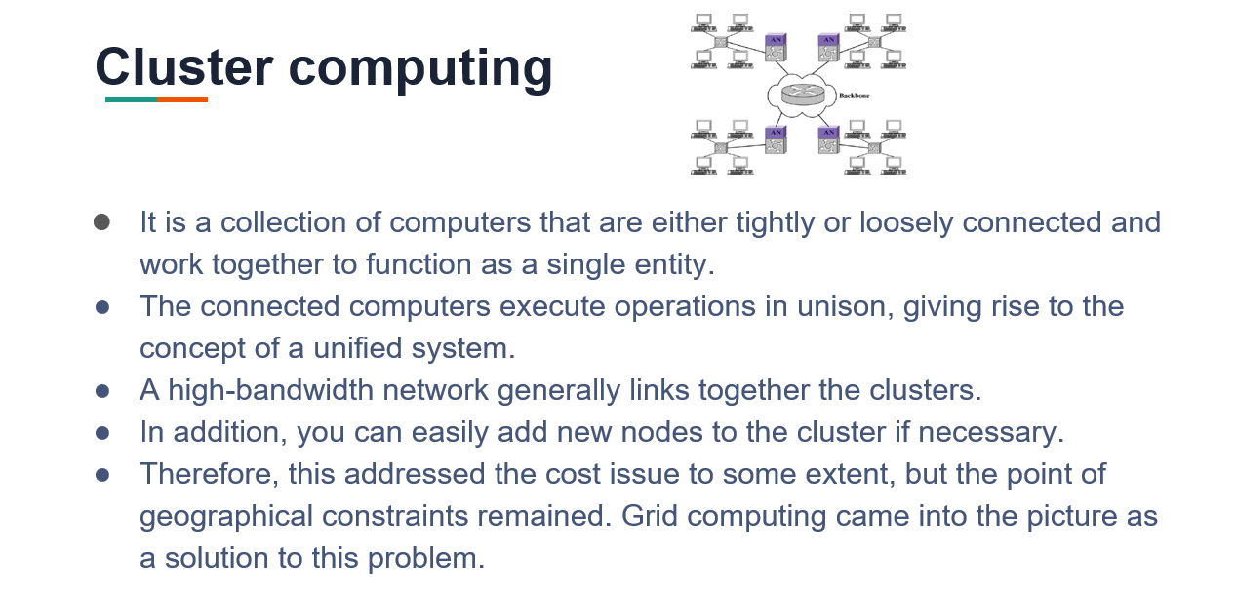

Slide 12
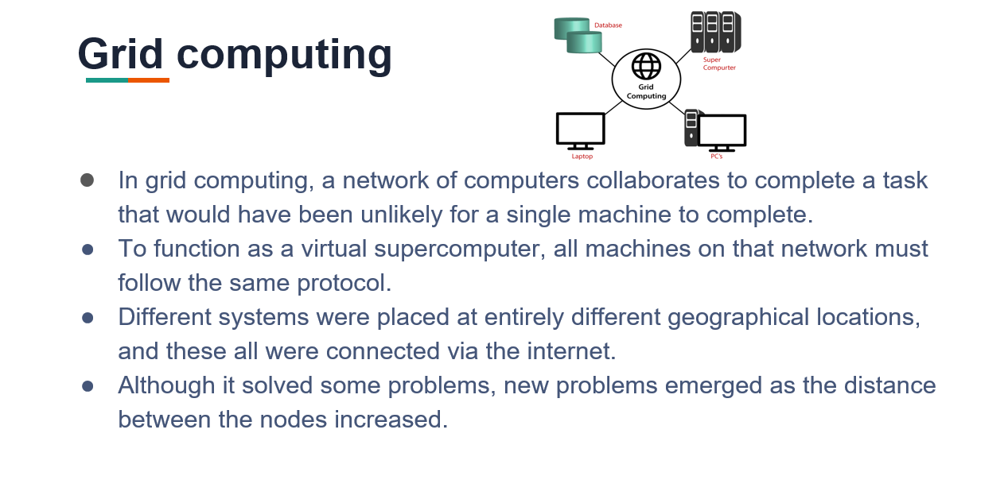

Slide 13
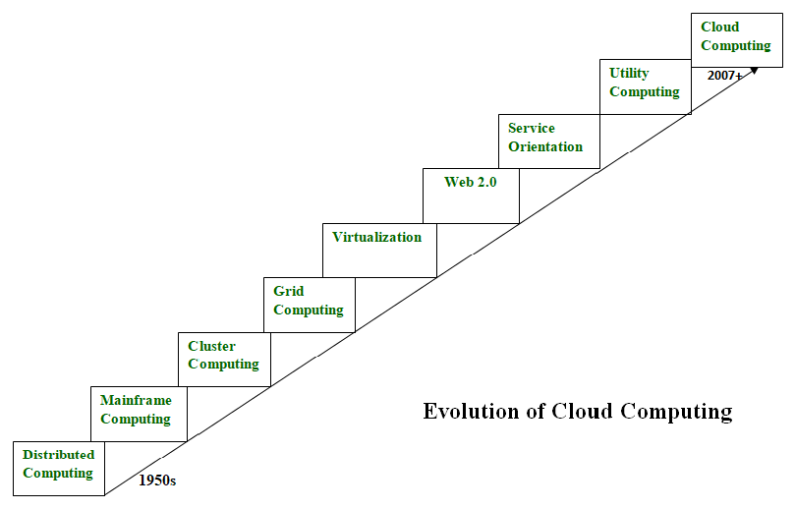

Slide 14
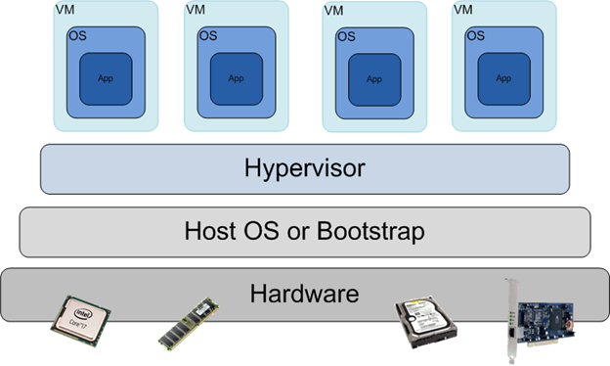
What is Virtualization
Virtualization in computing is the Process of simulating hardware and software in a Virtual (software) Environment

Slide 15
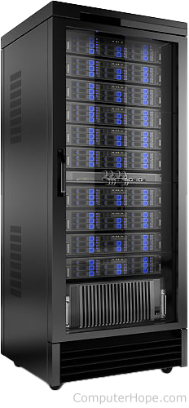
What is Virtualization
The traditional way a business operates is by having one machine for one application
Email
Web server
Database

Slide 16
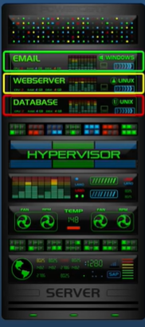
What is Virtualization
The traditional way a business operates is by having one machine for one application
Email
Web server
Database

Slide 17
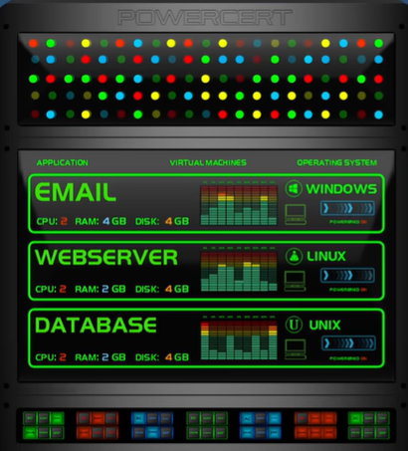
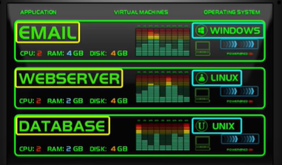
What is Virtualization
This one server is running 3 VMs(Virtual Machine)

Slide 18
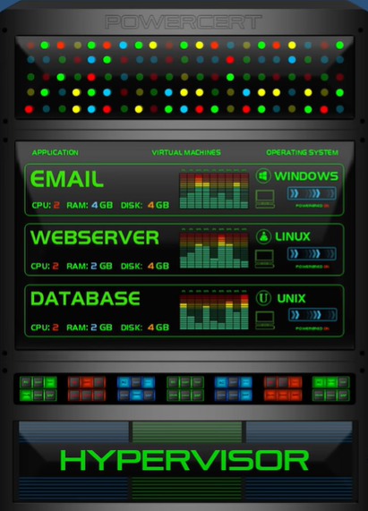
The software that created and runs the virtualization is called a hypervisor
It allocated and controls the sharing of a machine resources
Storage space
RAM
CPUs

Slide 19
What is a Hypervisor?
A hypervisor is a system software that acts as an intermediary between computer hardware and virtual machines. It is responsible for effectively allocating and harnessing hardware resources to be used by the respective virtual machines, that work individually on a physical host. For this reason, hypervisors are also called virtual machine managers.

Slide 20
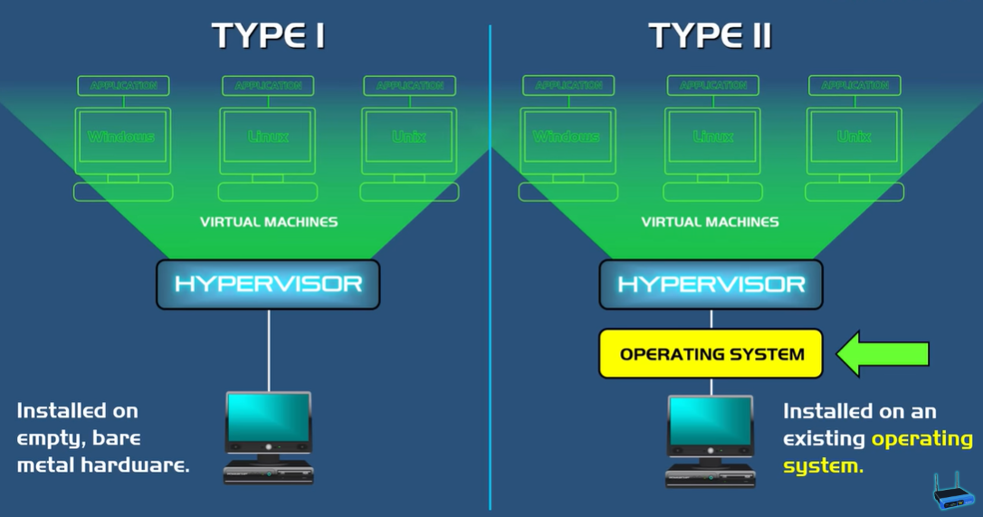

Slide 21
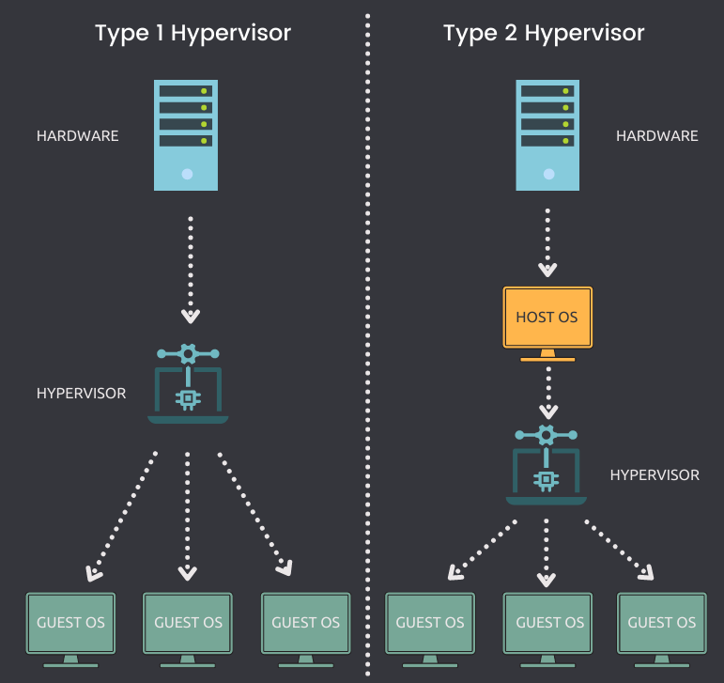

Slide 22
Examples
Type 1 Hypervisors AntsleOs, Xen, XCP-ng, Microsoft Hyper V, VMware ESX/ESXi, Oracle VM Server for x86 are some examples
Type 2 Hypervisors VMware Workstation, VMware Player, VirtualBox, Parallel Desktop for Mac

Slide 23
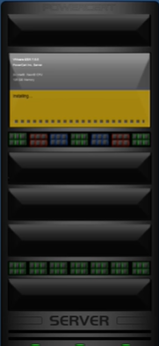
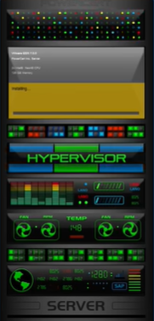
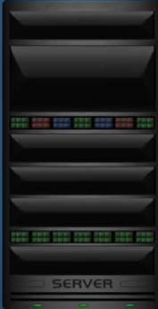
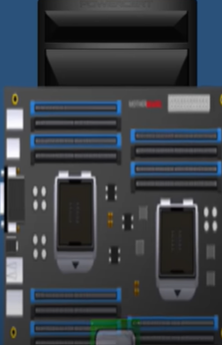
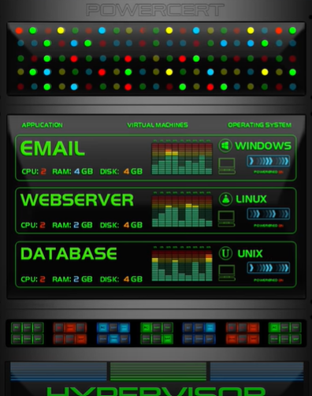
Add all the hardware components
Install Type 1 Hypervisor
Install Virtual Machines

Slide 24
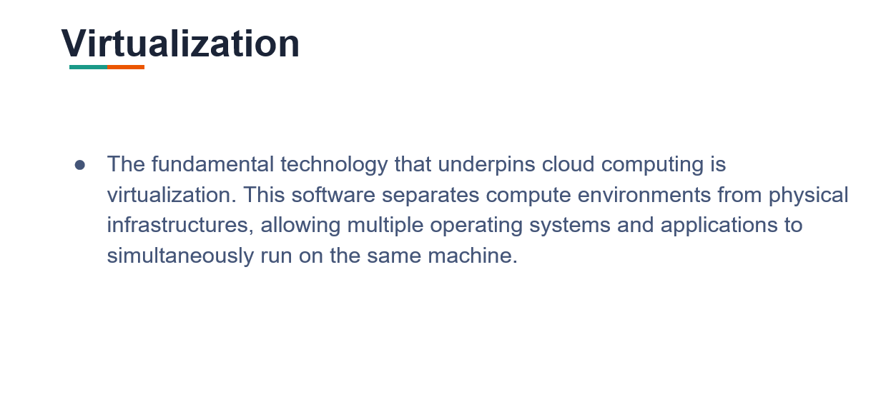

Slide 25
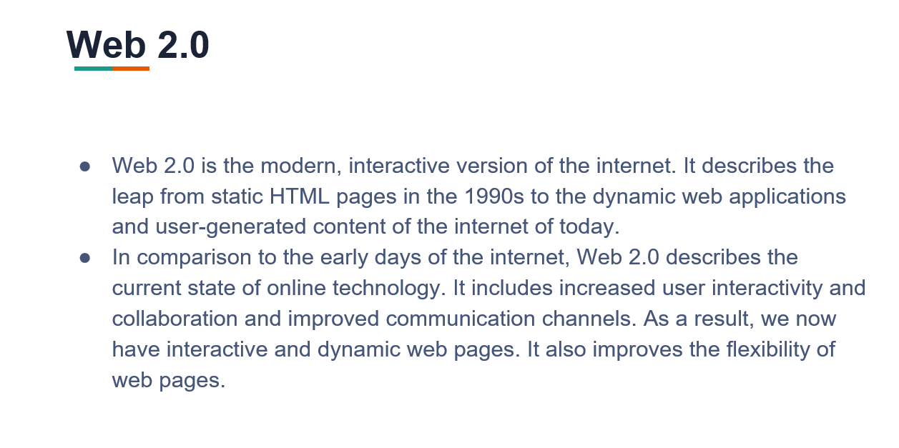

Slide 26
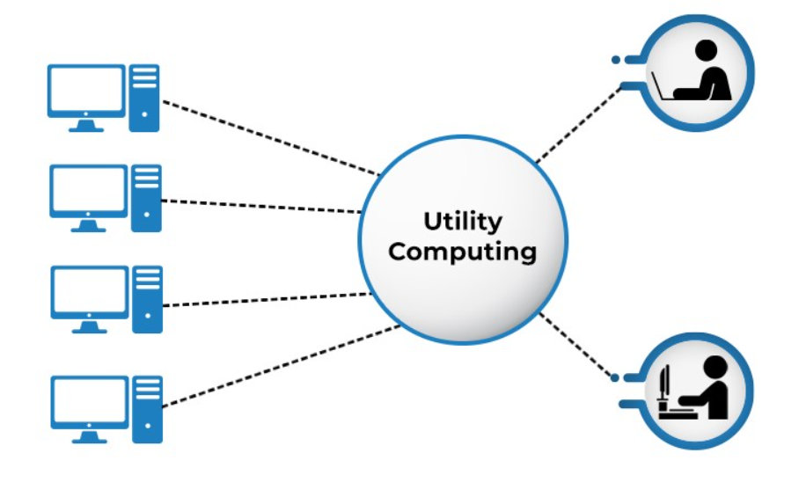
What Is Utility Computing?
Utility computing is a service provisioning model that offers computing resources such as hardware, software, and network bandwidth to clients as and when they require them on an on-demand basis. The service provider charges only as per the consumption of the services, rather than a fixed charge or a flat rate.

Slide 27
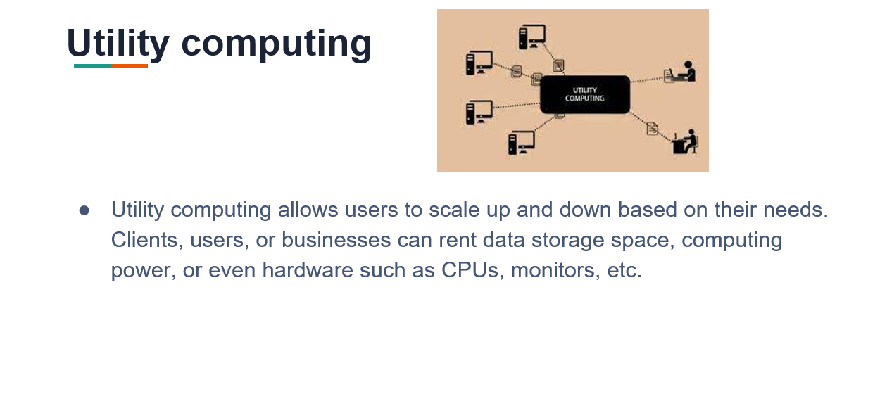

Slide 28
Service-Oriented Architecture

Slide 29
Service-Oriented Architecture
Service-Oriented Architecture (SOA) is a stage in the evolution of application development and/or integration. It defines a way to make software components reusable using the interfaces.
SOA allows users to combine a large number of facilities from existing services to form applications.

Slide 30
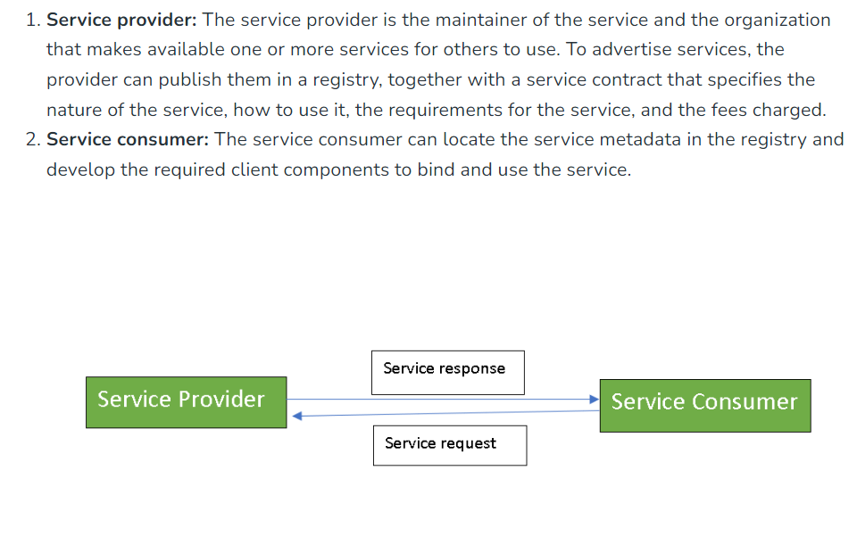

Slide 31
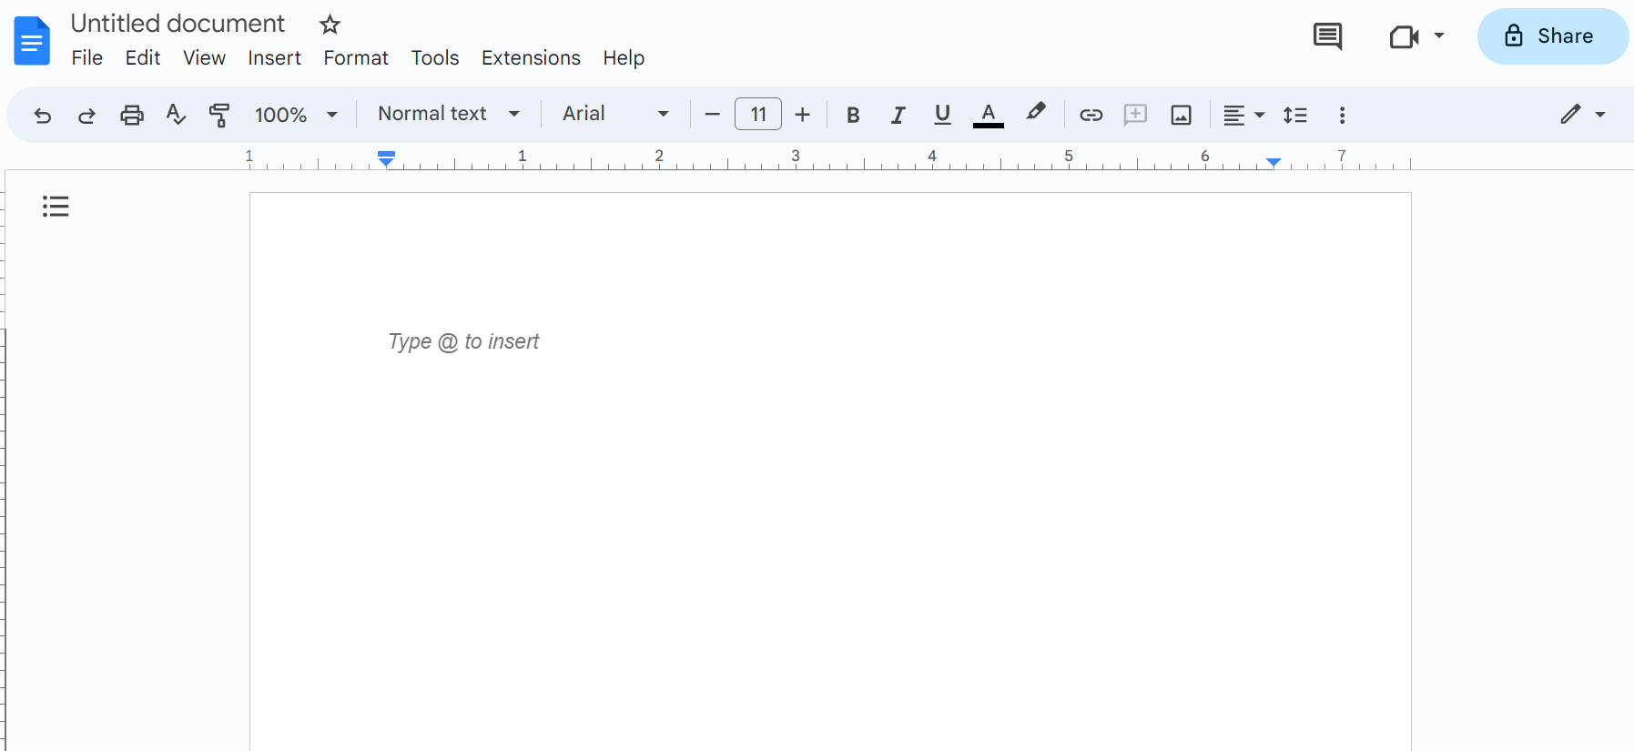

Slide 32
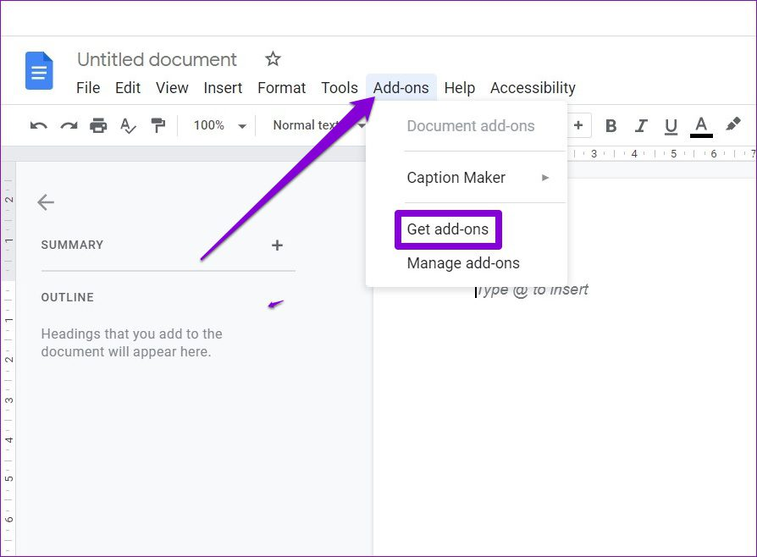

Slide 33
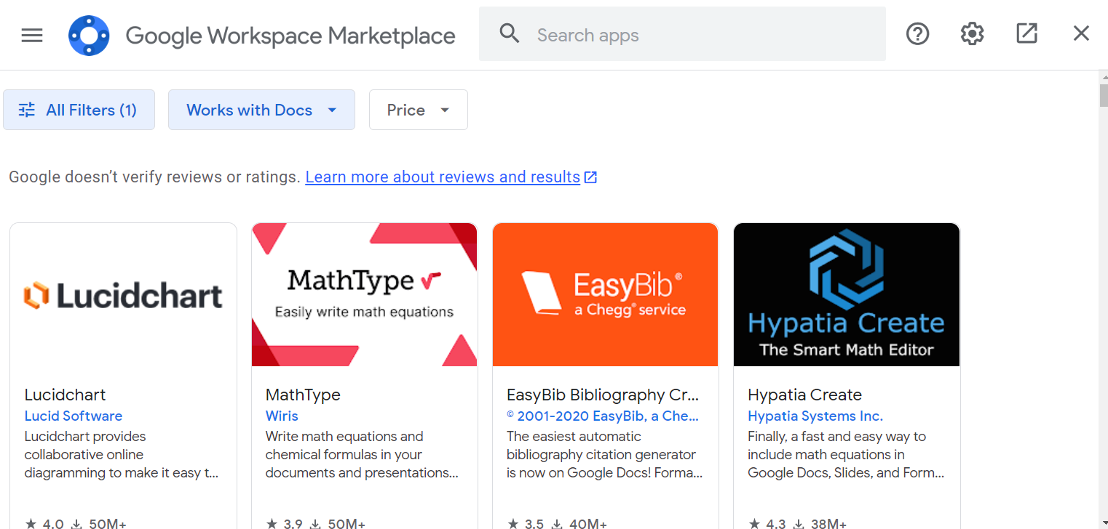

Slide 34
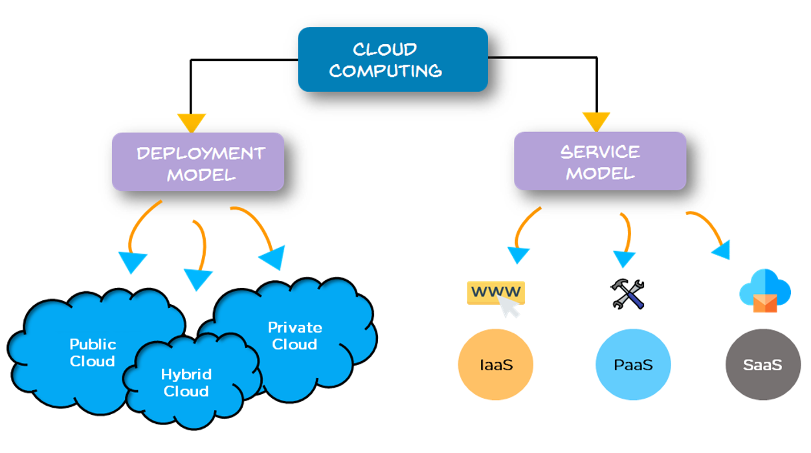

Slide 35
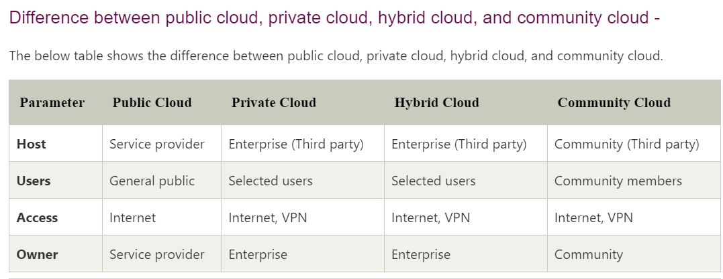

Slide 36
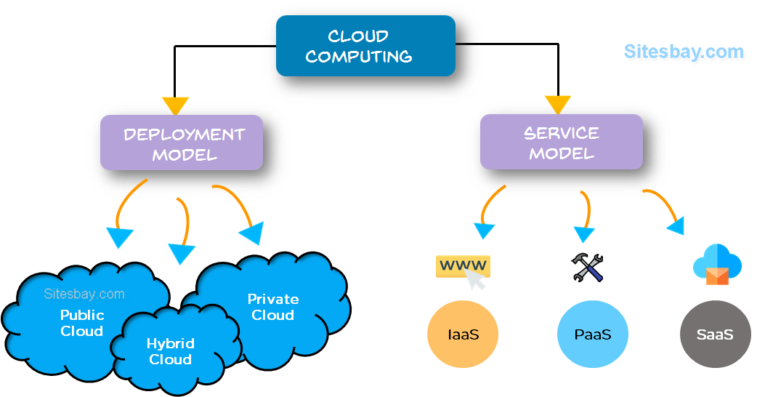

Slide 37
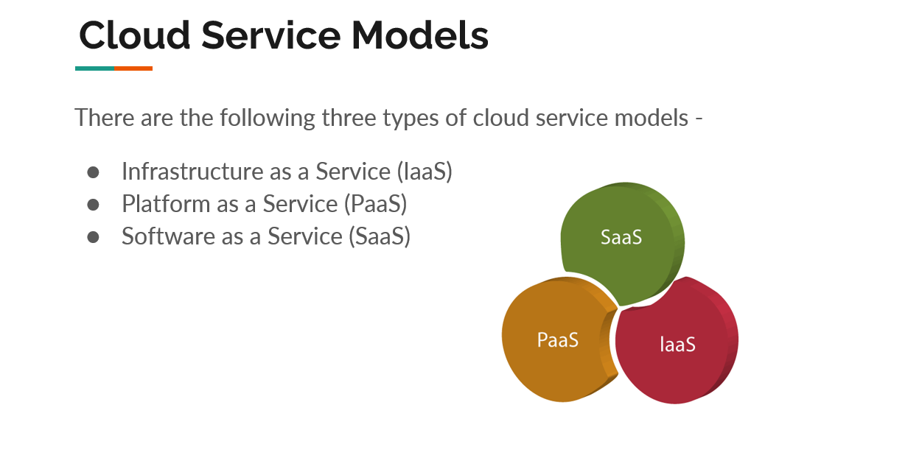

Slide 38
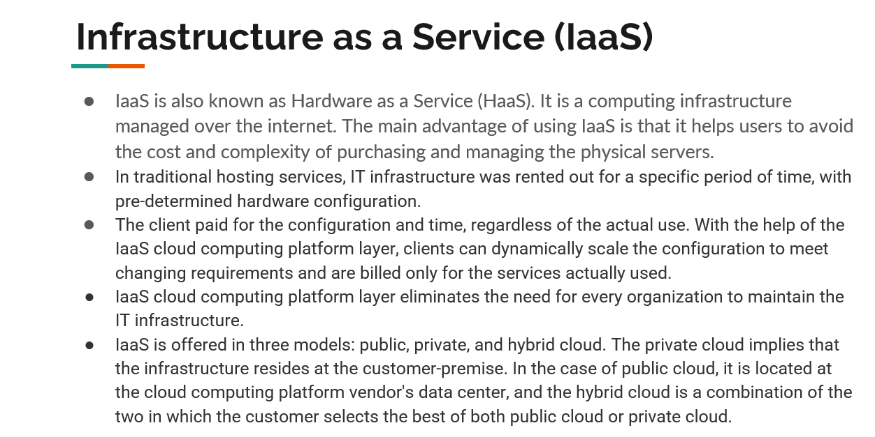

Slide 39
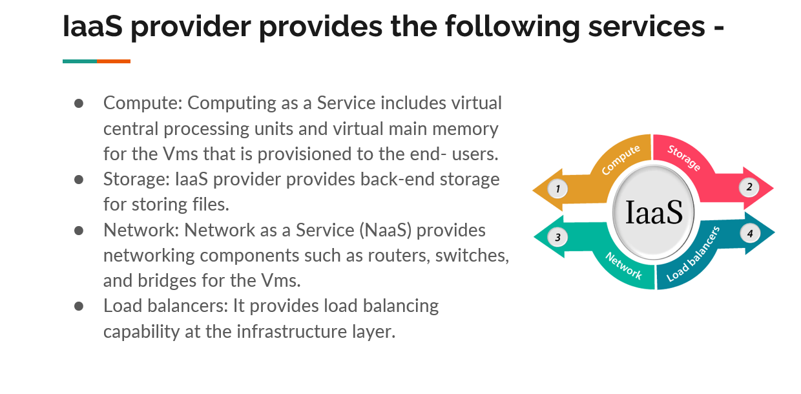

Slide 40
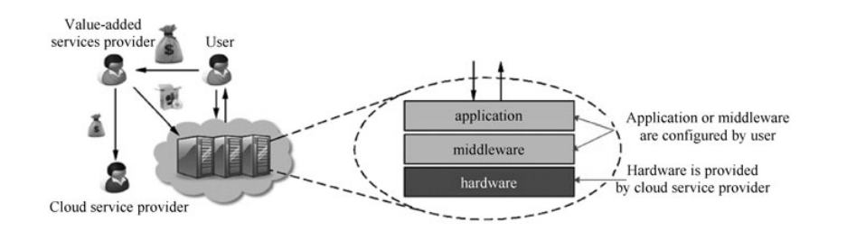

Slide 41
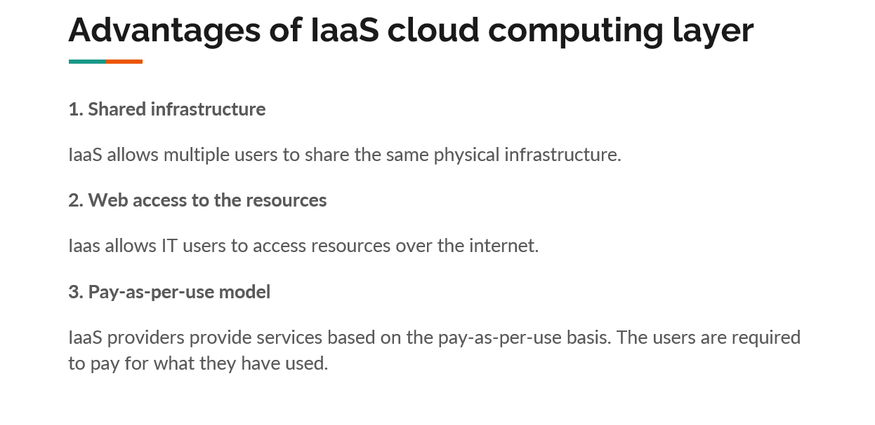

Slide 42
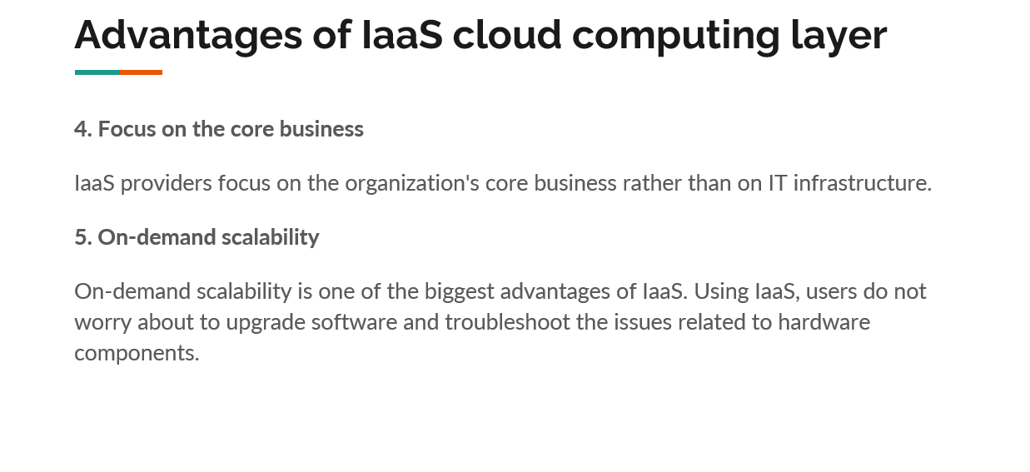

Slide 43
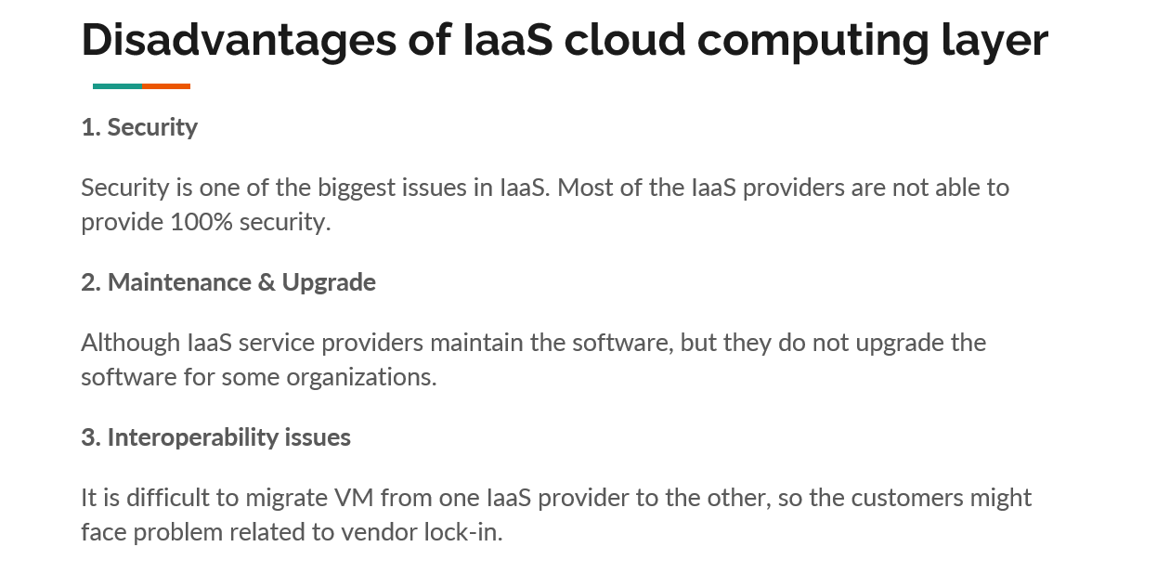

Slide 44
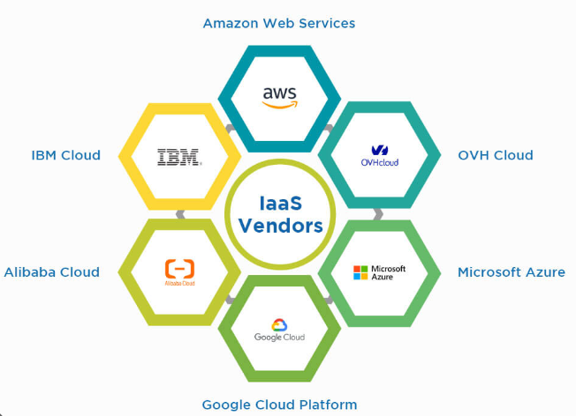

Slide 45
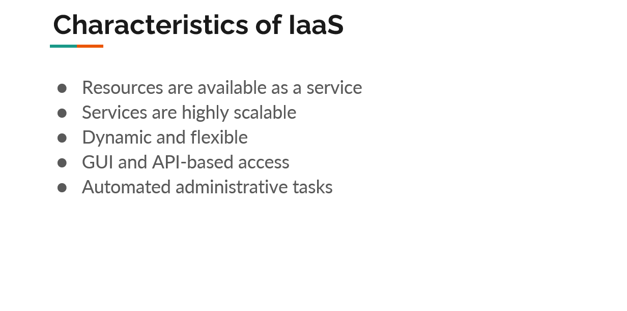

Slide 46
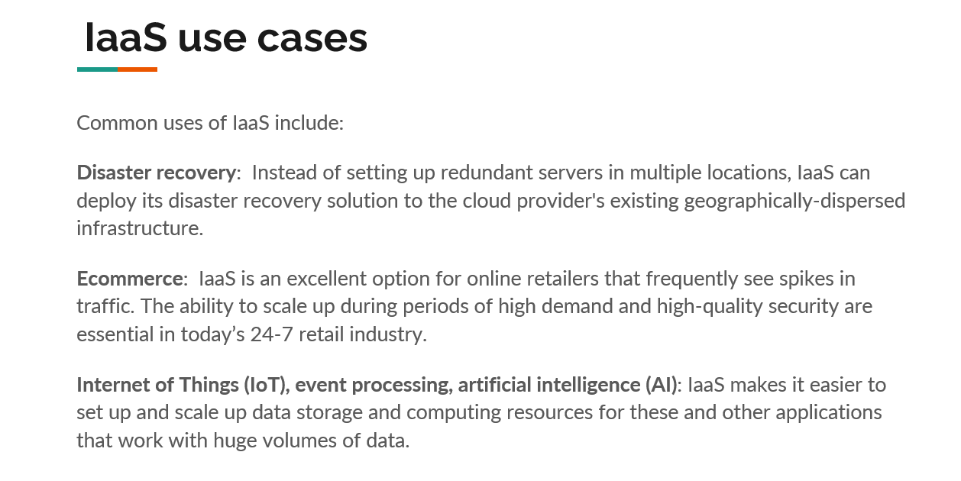

Slide 47
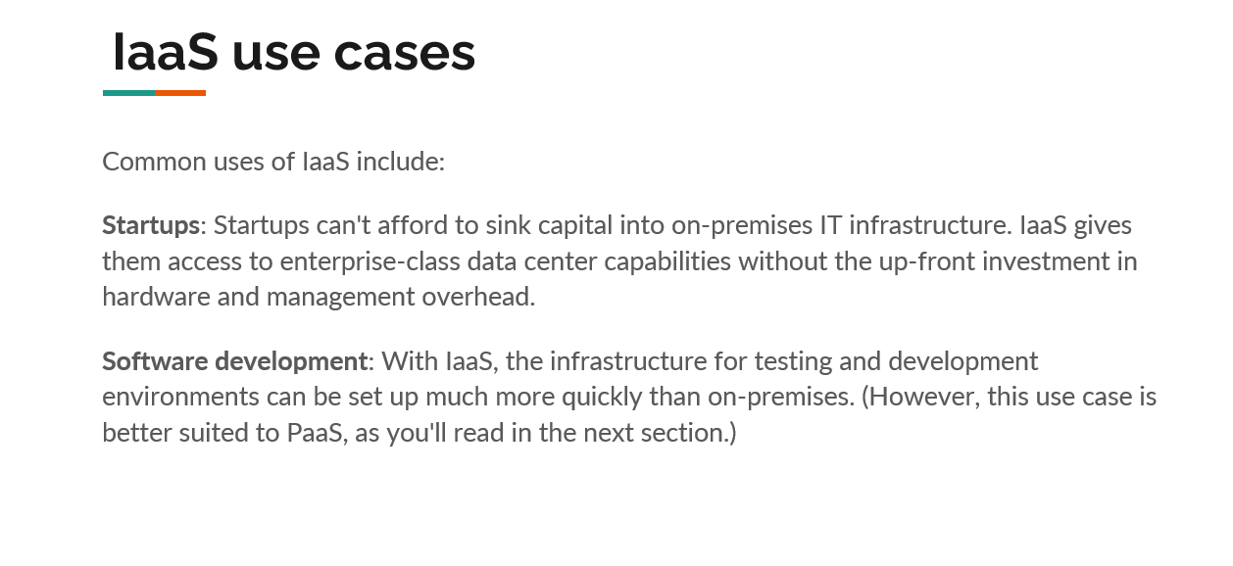

Slide 48
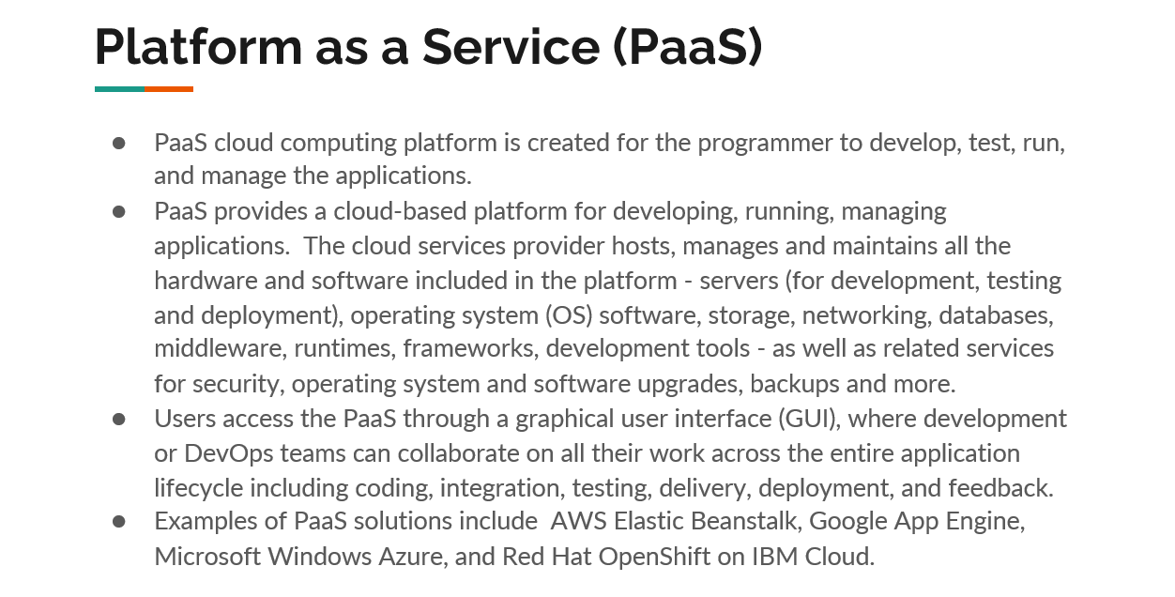

Slide 49
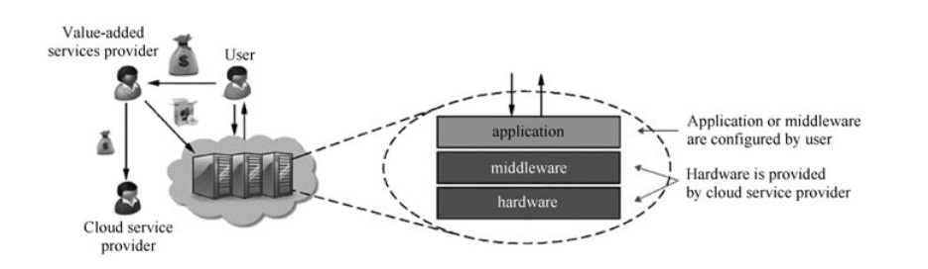

Slide 50
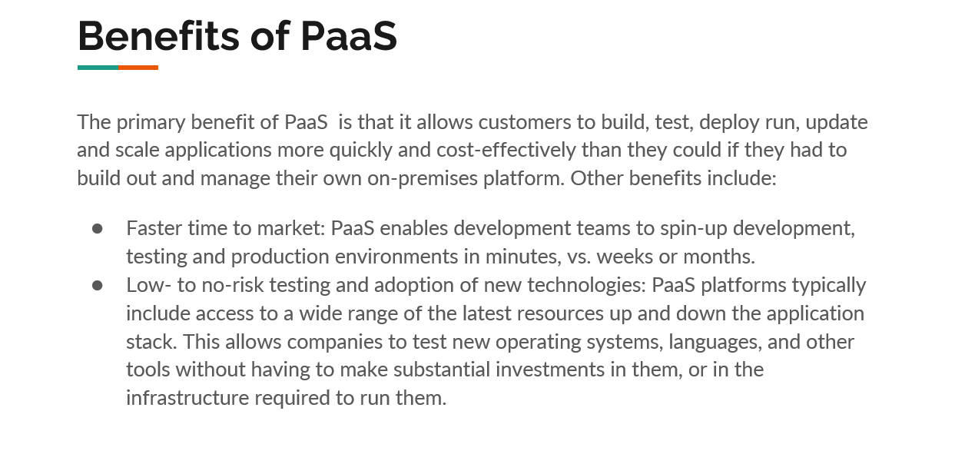

Slide 51
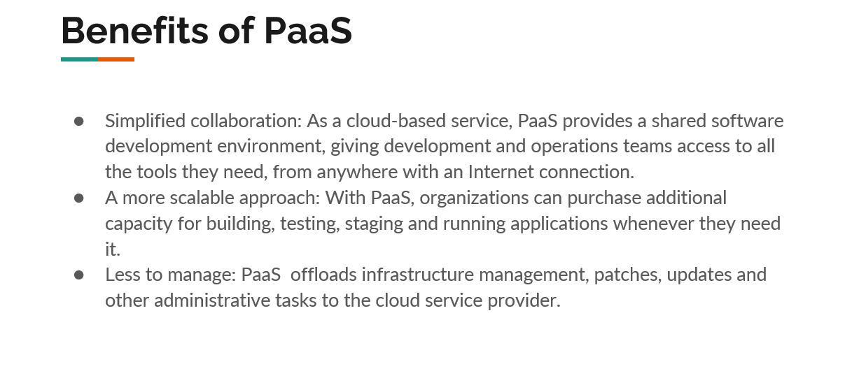

Slide 52
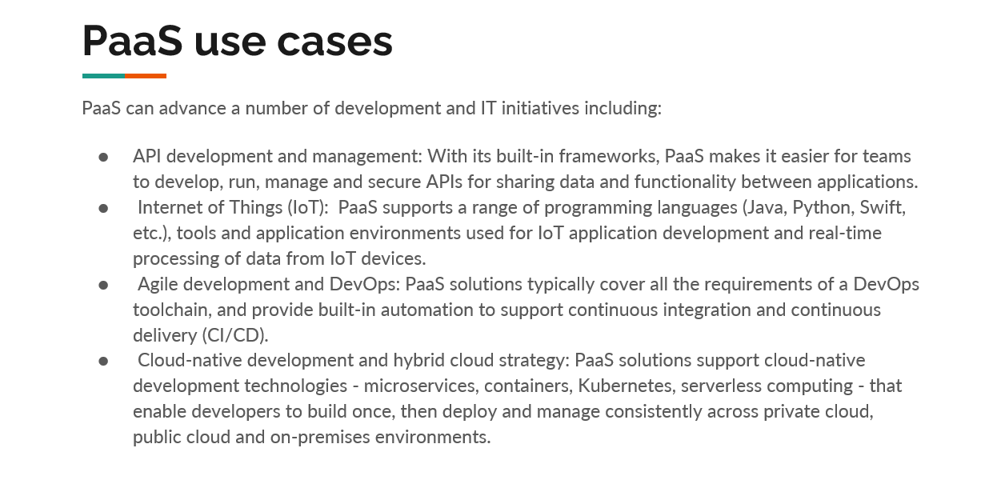

Slide 53


Slide 54


Slide 55


Slide 56


Slide 57


Slide 58


Slide 59


Slide 60


Slide 61


Slide 62


Slide 63


Slide 65


Slide 66


Slide 67


Slide 68


Slide 69


Slide 70


Slide 71


Slide 72


Slide 73


Slide 74


Slide 75


Slide 76


Slide 77


Slide 78


Slide 79


Slide 80


Slide 81


Slide 82


Slide 83


Slide 84


Slide 85


Slide 86

THANK YOU

Slide 87


Slide 88


Slide 89


Slide 90


Slide 91


Slide 92
Q.1
A.
B.
C.
D.

